Slide 1
Affordable 3D Printing Pitch Deck
Awais Amin(F2021-395)
Ammara Amin(F2021-394)

Slide 2
Table of contents
01
02
03
04
05
06
Introduction
Solution
Existing 3D Printers
Project Components
Contributions to Pak
Prev Experience

Slide 3
Introduction:
- Traditional manufacturing methods in Pakistan (machining, molding, casting, and subtractive manufacturing) are costly, time-consuming, and limit design possibilities.
In contrast, 3D printing offers dynamic adaptability, and rapid prototyping, suitable for
various sectors like engineering and building design.
- Pakistan faces challenges in manufacturing and hardware development, hindering access to advanced technologies like 3D printing.
- To address these challenges and promote 3D printing for education, hobbies, and manufacturing, we propose an affordable and accessible 3D printer.
- Our initiative aims to serve the needs of individuals and organizations in Pakistan, fostering technological innovation and enhancing 3D printing accessibility.

Slide 4
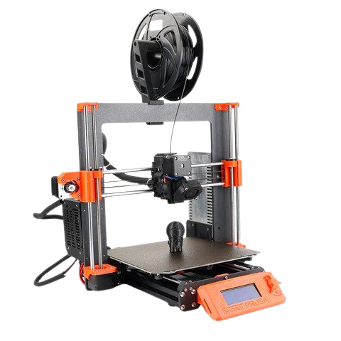
Existing 3D Printers in Pakistan & Problems:
These imported models often suffer from limitations, including:
High Cost
Technical Expertise
High Maintenance(wearout)
Limited Build Volume

Slide 5
Existing Printers Vs BOlT
 | ABL | Heated Bed | Speed | En- closed | Size | Price
OUR (Bolt) | ✔ | ✔ | ~250mm/s | ✔ | 400 mm³ | ~289$
Prusa i3 | ✔ | ✔ | 60mm/s | X | 220 mm³ | 999$
Ender3 | X | X | 50mm/s | X | 200 mm³ | 420$
Bambu A1 | ✔ | ✔ | 80mm/s | X | 180 mm³ | 450$
Bambu X1 C | ✔ | ✔ | 300mm/s | ✔ | 220 mm³ | $1,899

Slide 6
Solution for Developing an Accessible and Affordable 3D Printer:
Affordability:
Local Sourcing:
Open Source Platform:
Ranging from
75 to 80 PKR (~289$)
Sourcing components and materials from local markets.
All design files, firmware, and software open source and
readily available
User-Friendly Web Interface:
Improved Build Volume:
Self-Maintenance:
A user-friendly web interface accessible via a computer
User can produce 3D-printed replacement parts for our printer
Larger build volume of
400*400*400MM

Slide 7
Print Time
Avg print Time: 1h 55m 23s
Our Goal: ~30m 00s

Slide 8
Project Components
Web Interface
Hardware Component
Software Component
Arduino Microprocessor
Motion System
Heated Bed
Automatic Bed Leveling
Enclosed Frame
Frameworks
Firmware
Additional Dependencies
Low Level Languages
User-friendly platform
Accessibility
Real-Time Monitoring
Manual Control

Slide 9
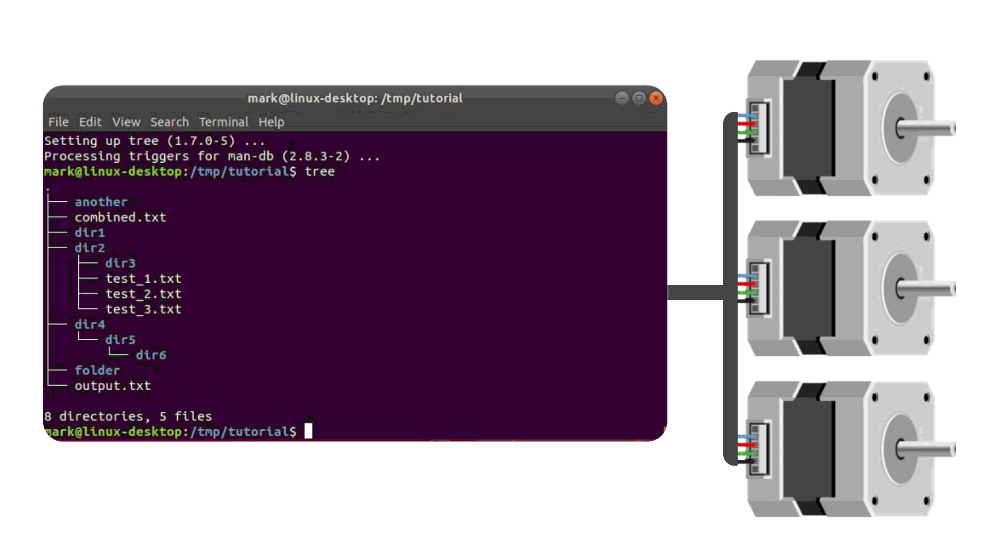
Software link-Layer
Controls
Frameworks
Firmware
Additional Dependencies
Low Level Languages

Slide 10
Software Components
AutoBedLevel:
LinearAdvance:
PidTempContorll:
To get perfect first layer
To get Sharp Corners
To reach The target Temp
CorexyKinematics:
TempOvershoot:
Input Shaping:
Translate Movement to CoreXY
To get nice Suface finish at high speed
To Prevent Fire Hazerds

Slide 11
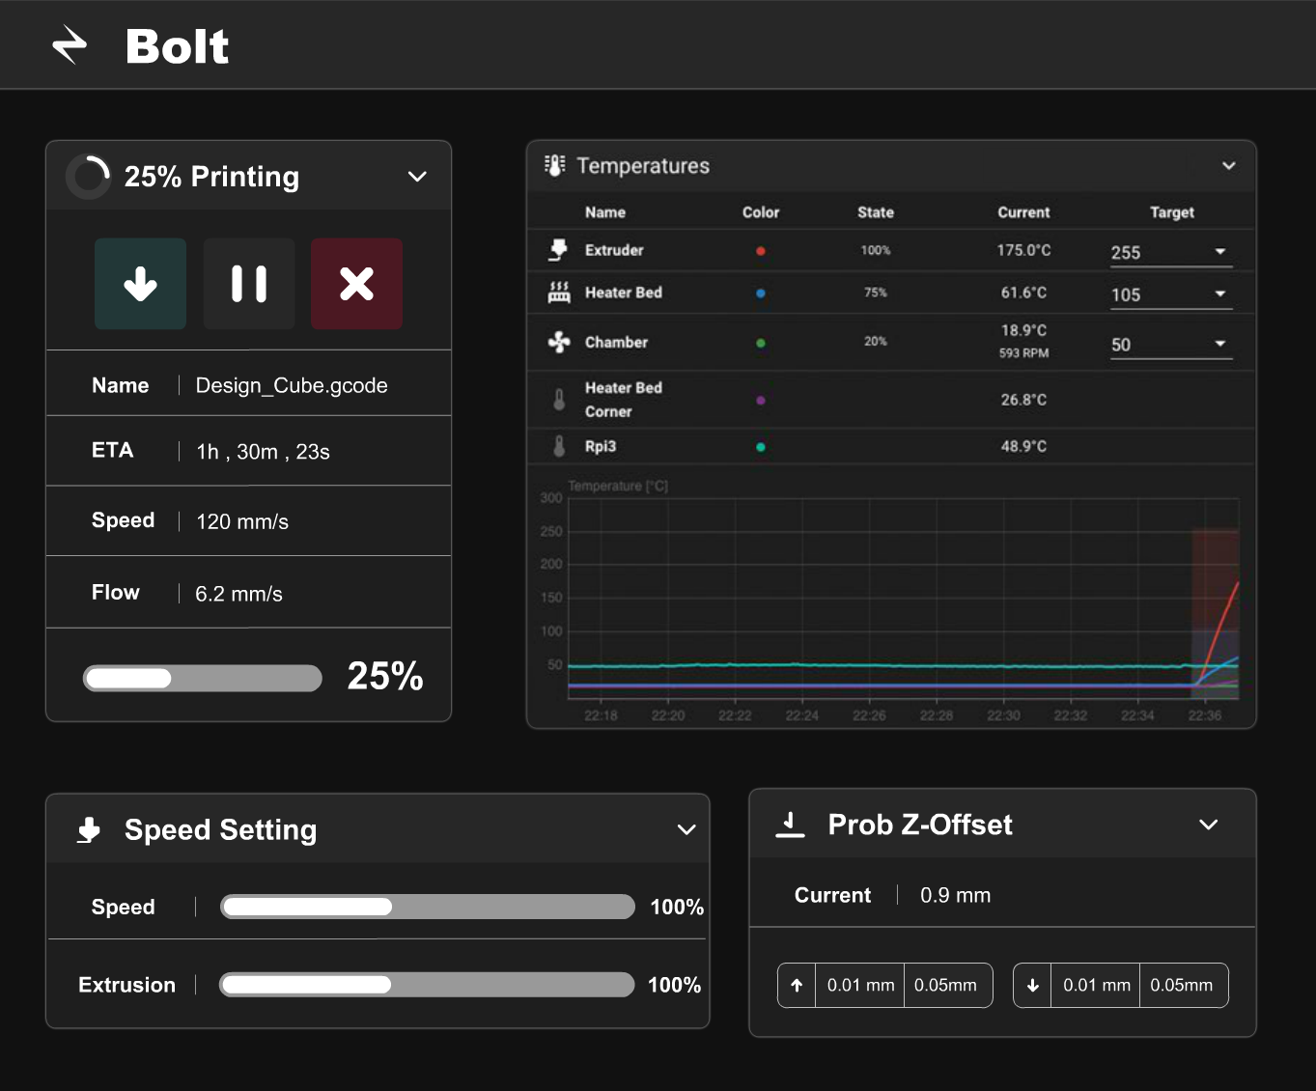
Web-InterFace
Features
User-friendly platform
Accessibility
Real-Time Monitoring
Manual Control

Slide 12

Contributions to Pakistan:
.Technological Advancement .Local Sourcing .Skills Development

Slide 13
Previous 3D Printing Experience
Maintenance and Repair
Filament Extruder Machine
Successfully maintained and fixed two 3D printers, gaining expertise in diagnosing and resolving printer issues.
Designed and built a filament extruder machine, demonstrating proficiency in working with complex machinery for filament production.
Firmware Modification
Independently modified the firmware of my old 3D printer, adding new features and conducting thorough testing and debugging.

Slide 14
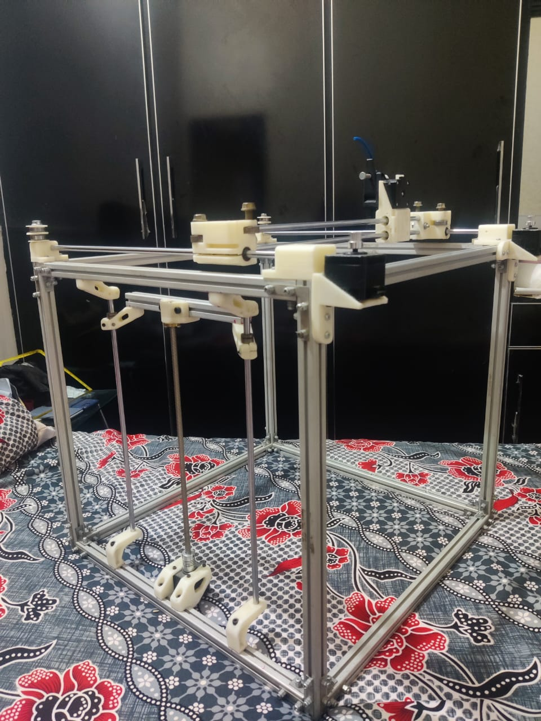
A_Square Bolt

Slide 15
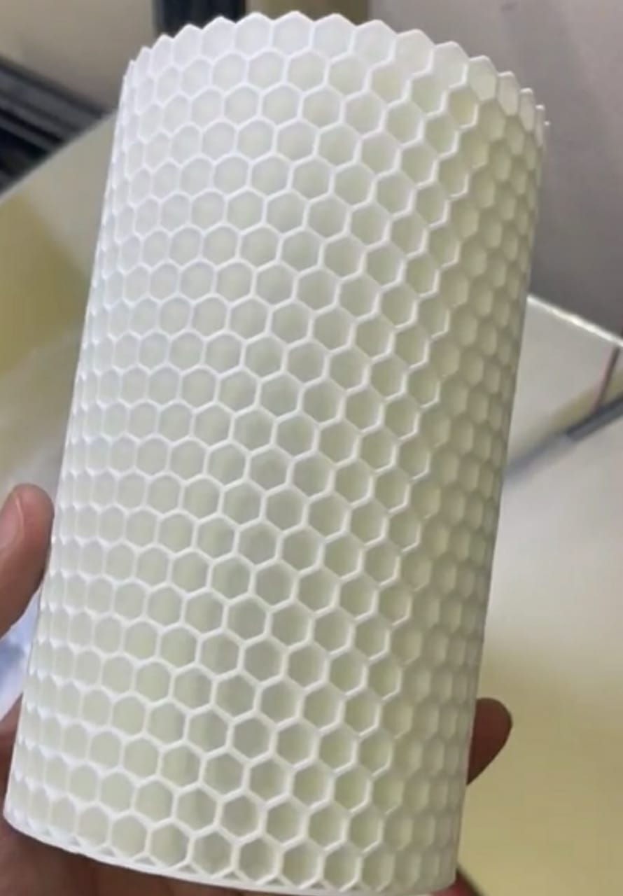
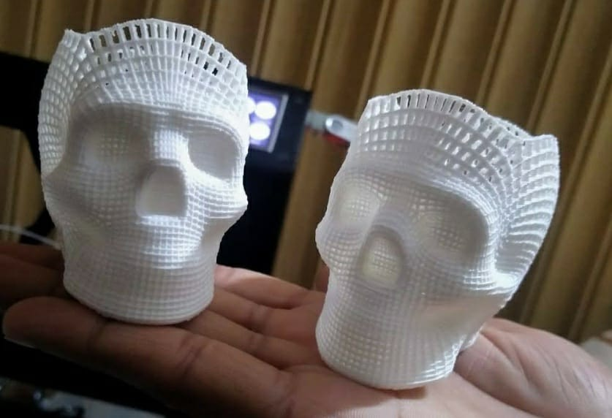
Complex objects that can be printed

Slide 16
Our Sources
60%
Discord
OpenSouce 3d printer community https://discord.com/voron
30%
WhatsApp-Group
Local 3d Printing Pakistan Community
3D Printing Pakistan
10%
Google
Good old Helper

Slide 17
A_Square Bolt

Slide 18
Thanks!
Do you have any questions?

